Slide 1

Team 3 - Food and drug administration (FDA) Recalls
Natalia galvan
Manuel Galvan
JOE ALMENDAREZ
Ziheng Song

Slide 2
Which firms have the most recalls? How much Time does it take to close a recall? Which States are impacted by recalls? What are the types of recall classifications?

Slide 3
Background FDA
The FDA is a US government agency which is part of the Department of Health and Human Services. The FDA's mission is to protect public health by regulating and ensuring the safety, efficacy, and security of many products. One of these products include food items.
Food items in violation of the US FDA regulations are recalled, which removes the recalled food item from the market.
We analyzed 500 recalled foods from the FDA for the time period of Jan-2020 – Aug-2024.

Slide 4
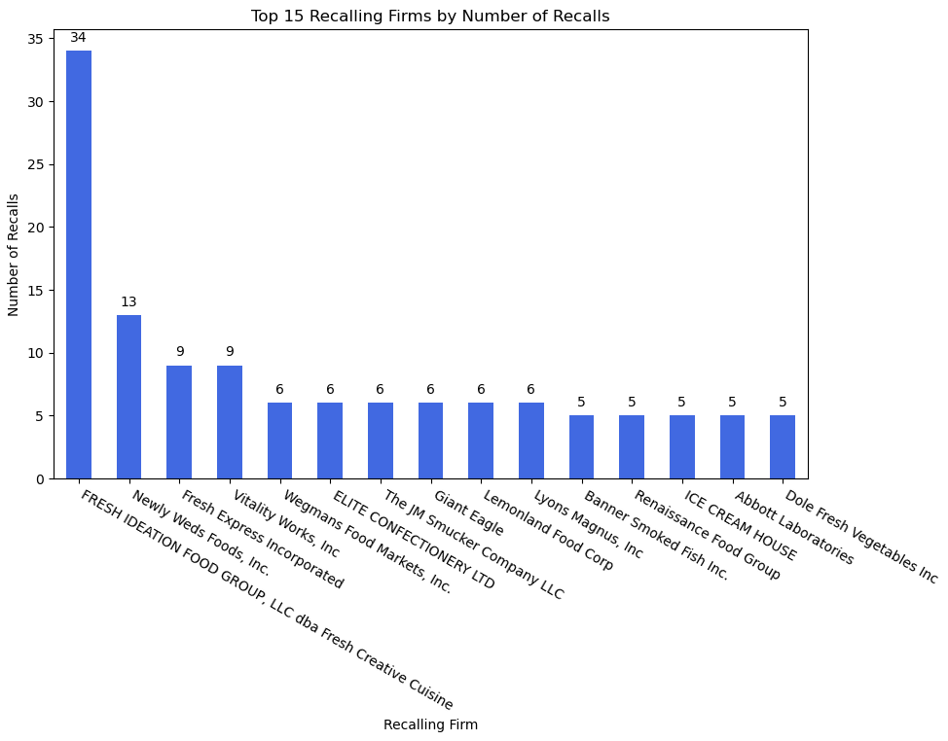
Which firms have the most recalls?
Total amount of unique Recalling Firms associated to the FDA Recalls is 295
Narrowed down to top 15
Top recalled firm
FRESH IDEATION FOOD GROUP, LLC dba Fresh Creative Cuisine
Artisan Sandwiches
Signature Salades
Snacks & Sides
Breakfast
Dessert

Slide 5
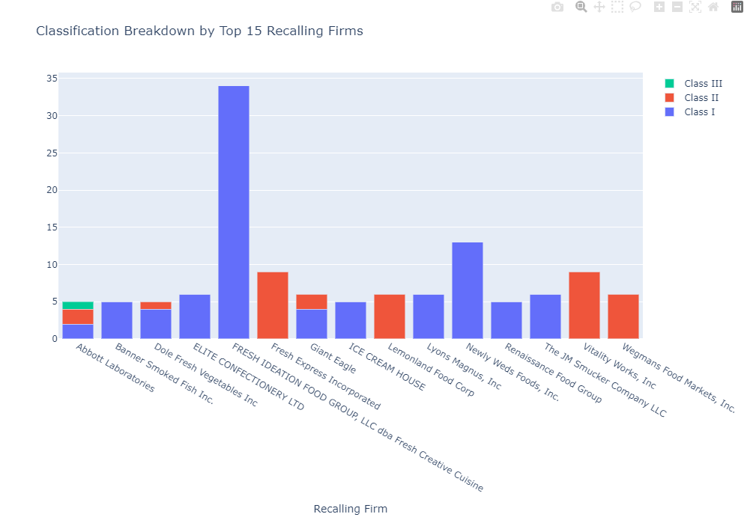
Which firms have the most recalls?
Class I - Most Serious / Dangerous,
Class II - Potentially Dangerous
Class III - Least Dangerous

Slide 6
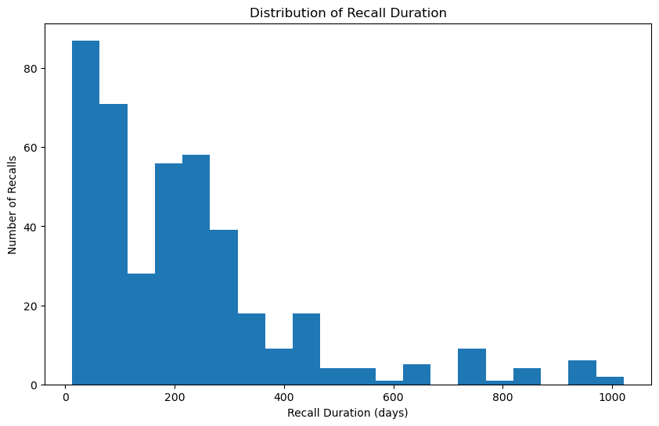
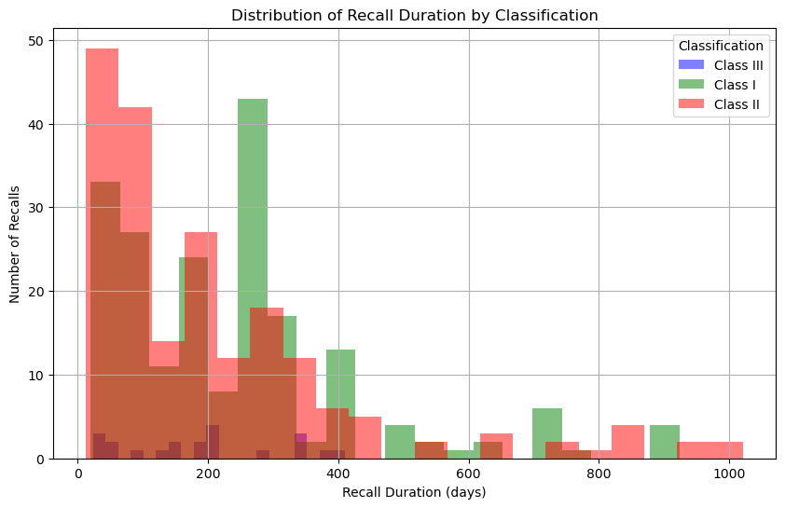
How much time does it usually take the fda to close out a recall?
A recall will be terminated when FDA determines that all reasonable efforts have been made to remove or correct the product in accordance with the recall strategy, and when it is reasonable to assume that the product subject to the recall has been removed and proper disposition or correction has been made
Average Time a Recall Stays Active:
Class I – 240 Days
Class II – 208 Days
Class III – 192 Days

Slide 7
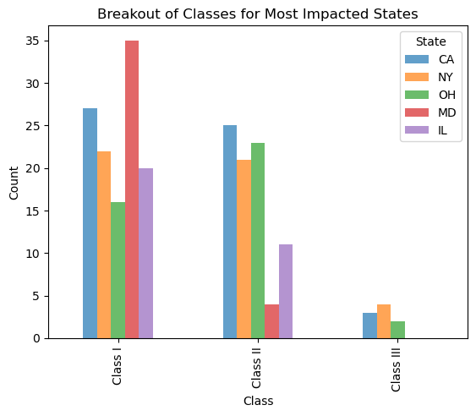
Geographical Distribution of FDA Recalls
The bar chart shows the distribution of FDA recalls across different states. The data highlights the following trends:
States with the highest recall counts.
Distribution of recall classes (Class I, Class II, Class III) within each state.
This analysis helps identify areas with higher recall activity and potential regional issues.

Slide 8
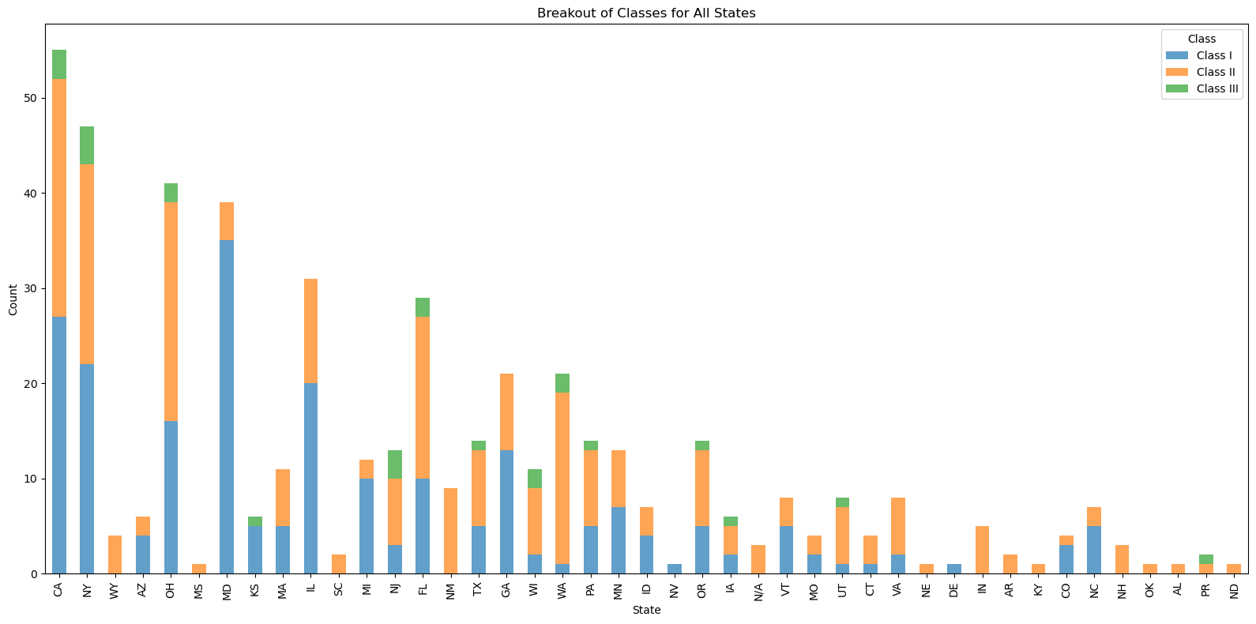
Breakout of Classes for All impacted States

Slide 9
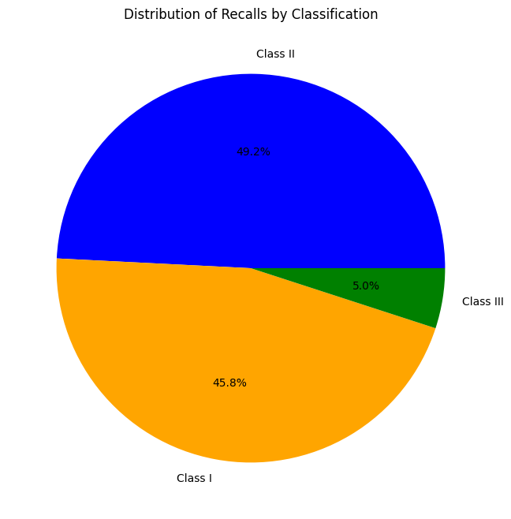
Recalls By Classification
Class I:
Definition: A situation where there is a reasonable probability that the use of or exposure to a violative product will cause serious adverse health consequences or death.
Class II:
Definition: A situation where the use of or exposure to a violative product may cause temporary or medically reversible adverse health consequences, or where the probability of serious adverse health consequences is remote.
Class III:
Definition: A situation where the use of or exposure to a violative product is not likely to cause adverse health consequences..
Class I 229
Class II 246
Class III 25

Slide 10
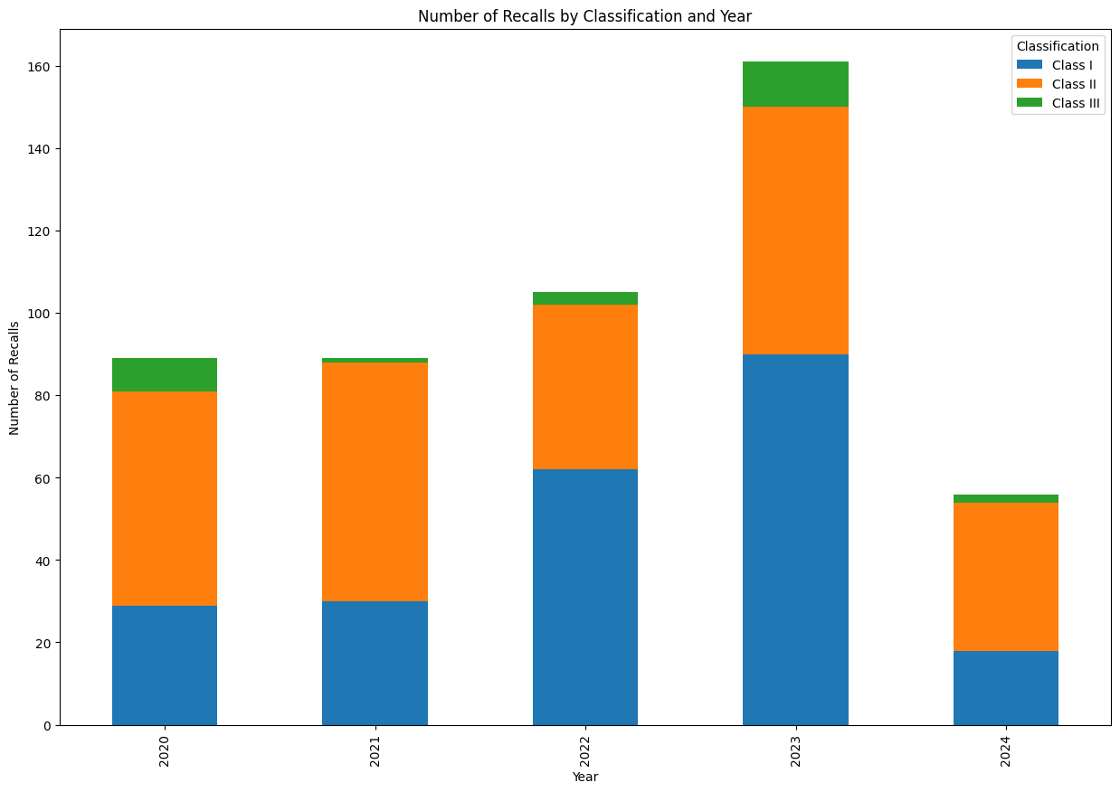
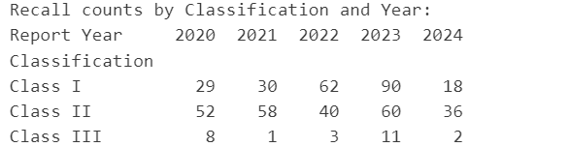
Number of Recalls by Class Type and Year
*2023 Class Type I recalls is higher than others
This usually indicates that there are more products posing serious risks, which could be a cause for heightened concern.

Slide 11
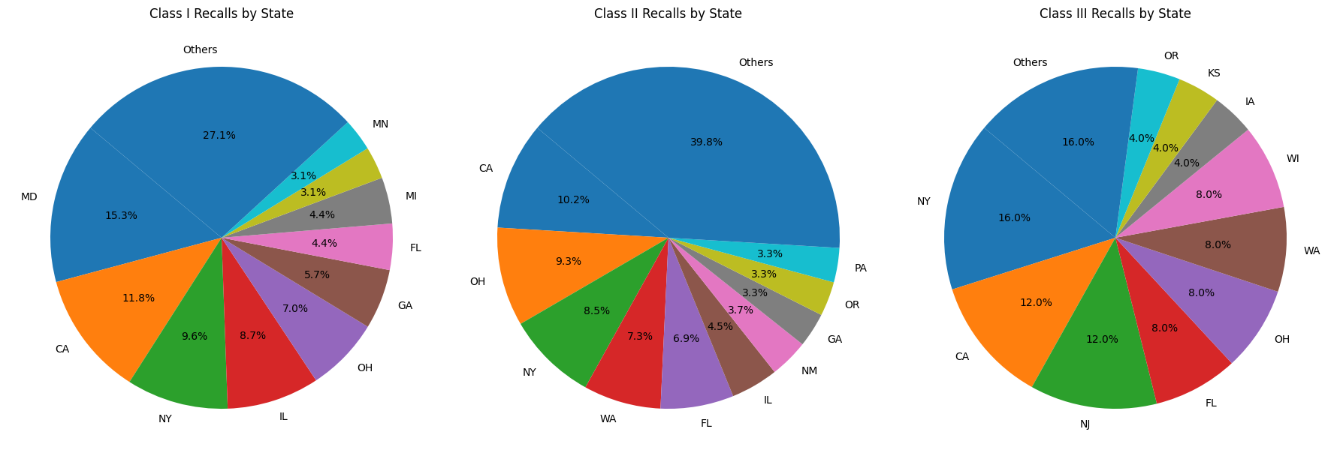
Class type recalls by state(TOP 10 State)

